Slide 1

Chapter 6 The Link Layer
and LANs
A note on the use of these PowerPoint slides:
We’re making these slides freely available to all (faculty, students, readers). They’re in PowerPoint form so you see the animations; and can add, modify, and delete slides (including this one) and slide content to suit your needs. They obviously represent a lot of work on our part. In return for use, we only ask the following:
If you use these slides (e.g., in a class) that you mention their source (after all, we’d like people to use our book!)
If you post any slides on a www site, that you note that they are adapted from (or perhaps identical to) our slides, and note our copyright of this material.
For a revision history, see the slide note for this page.
Thanks and enjoy! JFK/KWR
All material copyright 1996-2023
J.F Kurose and K.W. Ross, All Rights Reserved
Computer Networking: A Top-Down Approach 8th edition Jim Kurose, Keith Ross Pearson, 2020
Notes:
Version History
8.0 (May 2020)
All slides reformatted for 16:9 aspect ratio
All slides updated to 8th edition material
Use of Calibri font, rather that Gill Sans MT
Add LOTS more animation throughout
lighter header font
Updated datacenter slides, day-in-the-life
8.2 (July 2023): changes from 8.0
Minor updates throughout, including removal of master/slave
A few new slides added (transportation analogy, UMass LAN example, extended LANs)
Couple of not-used slides now hidden.

Slide 2

Link layer and LANs: our goals
understand principles behind link layer services:
error detection, correction
sharing a broadcast channel: multiple access
link layer addressing
local area networks: Ethernet, VLANs
datacenter networks
instantiation, implementation of various link layer technologies

Slide 3
Link layer, LANs: roadmap
introduction
error detection, correction
multiple access protocols
LANs
addressing, ARP
Ethernet
switches
VLANs
link virtualization: MPLS
data center networking
a day in the life of a web request

Slide 4








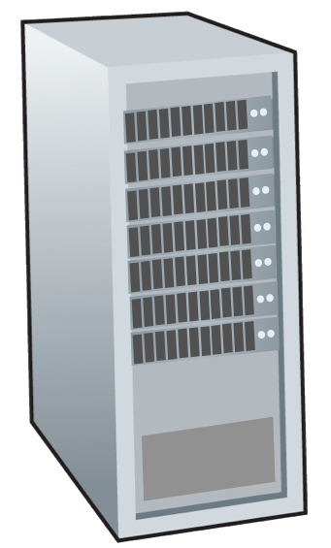







Link layer: introduction
terminology:
hosts, routers: nodes
communication channels that connect adjacent nodes along communication path: links
wired , wireless
LANs
layer-2 packet: frame, encapsulates datagram
mobile network
national or global ISP
datacenter
network
link layer has responsibility of
transferring datagram from one node
to physically adjacent node over a link
enterprise
network

Slide 5
Link layer: context
datagram transferred by different link protocols over different links:
e.g., WiFi on first link, Ethernet on next link
each link protocol provides different services
e.g., may or may not provide reliable data transfer over link

Slide 6







Transportation analogy
transportation analogy:
trip from Princeton to Lausanne
limo: Princeton to JFK
plane: JFK to Geneva
train: Geneva to Lausanne
tourist = datagram
transport segment = communication link
transportation mode = link-layer protocol
travel agent = routing algorithm
Princeton
JFK
Geneva
Lausanne

Slide 7


Link layer: services
framing, link access:
encapsulate datagram into frame, adding header, trailer
channel access if shared medium
“MAC” addresses in frame headers identify source, destination (different from IP address!)
reliable delivery between adjacent nodes
we already know how to do this!
seldom used on low bit-error links
wireless links: high error rates
Q: why both link-level and end-end reliability?
…
…
Cable access
cellular
Ethernet LANs
WiFi
Notes:
reliable delivery between adjacent nodes
Not always
Rdt likes we studied in transport layer
Reliable is not as important is correctness. How is correctness assured?
Wireless is subjected to noise, interference and has high bit error rate.
Why

Slide 8
Link layer: services (more)
…
flow control:
pacing between adjacent sending and receiving nodes
error detection:
errors caused by signal attenuation, noise.
receiver detects errors, signals retransmission, or drops frame
error correction:
receiver identifies and corrects bit error(s) without retransmission
half-duplex and full-duplex:
with half duplex, nodes at both ends of link can transmit, but not at same time
…
Cable access
cellular
Ethernet LANs
WiFi
Notes:
Error detection in the link layer is usually more sophisticated and is implemented in hardware. Error correction is similar to error detection, except that a receiver not only detects when bit errors have occurred in the frame but also deter- mines exactly where in the frame the errors have occurred (and then corrects these errors).

Slide 9
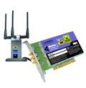
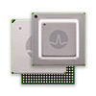

Host link-layer implementation
in each-and-every host
link layer implemented on-chip or in network interface card (NIC)
implements link, physical layer
attaches into host’s system buses
combination of hardware, software, firmware
application
transport
network
link
cpu
memory
host bus
(e.g., PCI)
controller
link
physical
physical
network interface
Notes:
The Ethernet capabilities are either integrated into the motherboard chipset or implemented via a low-cost dedicated Ethernet chip. For the most part, the link layer is implemented on a chip called the network adapter, also sometimes known as a network interface controller (NIC). The network adapter implements many link layer services including framing, link access, error detection, and so on. Thus, much of a link-layer controller’s functionality is implemented in hardware. For example, Intel’s 700 series adapters [Intel 2020] implements the Ethernet protocols we’ll study in Section 6.5; the Atheros AR5006 [Atheros 2020] controller implements the 802.11 WiFi protocols we’ll study in Chapter 7.
Figure 6.2 shows that while most of the link layer is implemented in hardware, part of the link layer is implemented in software that runs on the host’s CPU. The software components of the link layer implement higher-level link-layer functionality such as assembling link-layer addressing information and activating the controller hardware. On the receiving side, link-layer software responds to con- troller interrupts (for example, due to the receipt of one or more frames), handling error conditions and passing a datagram up to the network layer. Thus, the link layer is a combination of hardware and software

Slide 10
Interfaces communicating
application
transport
network
link
application
transport
network
link
cpu
memory
memory
CPU
datagram
link_{h}
datagram
controller
controller
datagram
link_{h}
link
physical
link
physical
physical
physical
sending side:
encapsulates datagram in frame
adds error checking bits, reliable data transfer, flow control, etc.
receiving side:
looks for errors, reliable data transfer, flow control, etc.
extracts datagram, passes to upper layer at receiving side

Slide 11
Link layer, LANs: roadmap
introduction
error detection, correction
multiple access protocols
LANs
addressing, ARP
Ethernet
switches
VLANs
link virtualization: MPLS
data center networking
a day in the life of a web request

Slide 12
Error detection
EDC: error detection and correction bits (e.g., redundancy)
D: data protected by error checking, may include header fields
datagram
datagram
Error detection not 100% reliable!
protocol may miss some errors, but rarely
larger EDC field yields better detection and correction
otherwise
all
bits in D’
OK
?
N
detected
error
d data bits
D
EDC
D’
EDC’
bit-error prone link

Slide 13

Parity checking
Can detect and correct errors (without retransmission!)
two-dimensional parity: detect and correct single bit errors
single bit parity:
detect single bit errors
0111000110101011
1
row parity
d data bits
d_{1,1}
. . .
d_{1,j}
d_{1,j+1}
d_{2,1}
. . .
d_{2,j}
d_{2,j+1}
parity bit
. . .
. . .
. . .
. . .
Even/odd parity: set parity bit so there is an even/odd number of 1’s
d_{i,1}
. . .
d_{i,j}
d_{i,j+1}
column
parity
d_{i+1,1}
. . .
d_{i+1,j}
d_{i+1,j+1}
At receiver:
compute parity of d received bits
compare with received parity bit – if different than error detected
no errors:
1 0 1 0 1
1
detected
and
correctable
single-bit
error:
1 0 1 0 1 1
1 1 1 1 0
0
1 0 1 1 0 0
parity
error
0 1 1 1 0
1
0 1 1 1 0 1
1 0 1 0 1
0
1 0 1 0 1 0
parity
error
* Check out the online interactive exercises for more examples: http://gaia.cs.umass.edu/kurose_ross/interactive/

Slide 14
Internet checksum (review, see section 3.3)
Goal: detect errors (i.e., flipped bits) in transmitted segment
sender:
treat contents of UDP segment (including UDP header fields and IP addresses) as sequence of 16-bit integers
checksum: addition (one’s complement sum) of segment content
checksum value put into UDP checksum field
receiver:
compute checksum of received segment
check if computed checksum equals checksum field value:
not equal - error detected
equal - no error detected. But maybe errors nonetheless? More later ….

Slide 15
Cyclic Redundancy Check (CRC)
more powerful error-detection coding
D: data bits (given, think of these as a binary number)
G: bit pattern (generator), of r+1 bits (given, specified in CRC standard)
r CRC bits
d data bits
D
R
bits to send
<D,R> = D 2^{r} XOR R
formula for these bits
*
sender: compute r CRC bits, R, such that <D,R> exactly divisible by G (mod 2)
receiver knows G, divides <D,R> by G. If non-zero remainder: error detected!
can detect all burst errors less than r+1 bits
widely used in practice (Ethernet, 802.11 WiFi)

Slide 16
Cyclic Redundancy Check (CRC): example
G
Sender wants to compute R such that:
D . 2^{r} XOR R = nG
1
0
1
0 1 1
1 0 0 1
1 0 1 1 1 0
0 0 0
1 0 0 1
1 0 1
D
2^{r} (here, r=3)
0 0 0
*
... or equivalently (XOR R both sides):
D . 2^{r} = nG XOR R
1 0 1 0
1 0 0 1
1 1 0
... which says:
if we divide D . 2^{r} by G, we want remainder R to satisfy:
0 0 0
1 1 0 0
1 0 0 1
1 0 1 0
1 0 0 1
D.2^{r}
G
algorithm for
computing R
R = remainder [ ]
0 1 1
R
* Check out the online interactive exercises for more examples: http://gaia.cs.umass.edu/kurose_ross/interactive/

Slide 17
Link layer, LANs: roadmap
introduction
error detection, correction
multiple access protocols
LANs
addressing, ARP
Ethernet
switches
VLANs
link virtualization: MPLS
data center networking
a day in the life of a web request

Slide 18



Multiple access links, protocols
two types of “links”:
point-to-point
point-to-point link between Ethernet switch, host
PPP for dial-up access
broadcast (shared wire or medium)
old-school Ethernet
upstream HFC in cable-based access network
802.11 wireless LAN, 4G/4G. satellite
shared wire (e.g.,
cabled Ethernet)
shared radio: 4G/5G
shared radio: WiFi
shared radio: satellite
humans at a cocktail party
(shared air, acoustical)

Slide 19
Multiple access protocols
single shared broadcast channel
two or more simultaneous transmissions by nodes: interference
collision if node receives two or more signals at the same time
multiple access protocol
distributed algorithm that determines how nodes share channel, i.e., determine when node can transmit
communication about channel sharing must use channel itself!
no out-of-band channel for coordination

Slide 20
An ideal multiple access protocol
given: multiple access channel (MAC) of rate R bps
desiderata:
1. when one node wants to transmit, it can send at rate R.
2. when M nodes want to transmit, each can send at average rate R/M
3. fully decentralized:
no special node to coordinate transmissions
no synchronization of clocks, slots
4. simple

Slide 21
MAC protocols: taxonomy
three broad classes:
channel partitioning
divide channel into smaller “pieces” (time slots, frequency, code)
allocate piece to node for exclusive use
random access
channel not divided, allow collisions
“recover” from collisions
“taking turns”
nodes take turns, but nodes with more to send can take longer turns

Slide 22
Channel partitioning MAC protocols: TDMA
TDMA: time division multiple access
access to channel in “rounds”
each station gets fixed length slot (length = packet transmission time) in each round
unused slots go idle
example: 6-station LAN, 1,3,4 have packets to send, slots 2,5,6 idle
6-slot
frame
6-slot
frame
1
3
4
1
3
4

Slide 23
Channel partitioning MAC protocols: FDMA
FDMA: frequency division multiple access
channel spectrum divided into frequency bands
each station assigned fixed frequency band
unused transmission time in frequency bands go idle
example: 6-station LAN, 1,3,4 have packet to send, frequency bands 2,5,6 idle
time
frequency bands
FDM cable

Slide 24
Random access protocols
when node has packet to send
transmit at full channel data rate R
no a priori coordination among nodes
two or more transmitting nodes: “collision”
random access protocol specifies:
how to detect collisions
how to recover from collisions (e.g., via delayed retransmissions)
examples of random access MAC protocols:
ALOHA, slotted ALOHA
CSMA, CSMA/CD, CSMA/CA

Slide 25
Slotted ALOHA
operation:
when node obtains fresh frame, transmits in next slot
if no collision: node can send new frame in next slot
if collision: node retransmits frame in each subsequent slot with probability p until success
t₀
t₀+1
assumptions:
all frames same size
time divided into equal size slots (time to transmit 1 frame)
nodes start to transmit only slot beginning
nodes are synchronized
if 2 or more nodes transmit in slot, all nodes detect collision
randomization – why?

Slide 26
Slotted ALOHA
node 1
1
1
1
1
C: collision
S: success
E: empty
node 2
2
2
2
node 3
3
3
3
C
E
C
S
E
C
E
S
S
Pros:
single active node can continuously transmit at full rate of channel
highly decentralized: only slots in nodes need to be in sync
simple
Cons:
collisions, wasting slots
idle slots
nodes may be able to detect collision in less than time to transmit packet
clock synchronization
Notes:
Slotted ALOHA would appear to have many advantages. Unlike channel partitioning, slotted ALOHA allows a node to transmit continuously at the full rate, R, when that node is the only active node. (A node is said to be active if it has frames to send.) Slotted ALOHA is also highly decentralized, because each node detects collisions and independently decides when to retransmit. (Slotted ALOHA does, however, require the slots to be synchronized in the nodes; shortly we’ll discuss an unslotted version of the ALOHA protocol, as well as CSMA protocols, none of which require such synchronization.) Slotted ALOHA is also an extremely simple protocol.

Slide 27

Slotted ALOHA: efficiency
efficiency: long-run fraction of successful slots (many nodes, all with many frames to send)
suppose: N nodes with many frames to send, each transmits in slot with probability p
prob that given node has success in a slot = p(1-p)^{N-1}
prob that any node has a success = Np(1-p)^{N-1}
max efficiency: find p* that maximizes Np(1-p)^{N-1}
for many nodes, take limit of Np*(1-p*)^{N-1} as N goes to infinity, gives:
max efficiency = 1/e = .37
at best: channel used for useful transmissions 37% of time!
Notes:
Suppose there are N nodes. Then the probability that a given slot is a successful slot is the probability that one of the nodes transmits and that the remaining N - 1 nodes do not transmit. The probability that a given node transmits is p; the probability that the remaining nodes do not transmit is (1 - p)N-1. Therefore, the probability a given node has a success is p(1 - p)N-1. Because there are N nodes, the probability that any one of the N nodes has a success is Np(1 - p)N - 1.
only 37 percent of the slots do useful work. Thus, the effective transmission rate of the channel is not R bps but only 0.37 R bps! A similar analysis also shows that 37 percent of the slots go empty and 26 percent of slots have collisions.

Slide 28
Pure ALOHA
unslotted Aloha: simpler, no synchronization
when frame first arrives: transmit immediately
collision probability increases with no synchronization:
frame sent at t₀ collides with other frames sent in [t₀-1,t₀+1]
will overlap
with start of
i’s frame
will overlap
with end of
i’s frame
t₀ - 1
t₀
t₀ + 1
pure Aloha efficiency: 18% !

Slide 29
CSMA (carrier sense multiple access)
simple CSMA: listen before transmit:
if channel sensed idle: transmit entire frame
if channel sensed busy: defer transmission
human analogy: don’t interrupt others!
CSMA/CD: CSMA with collision detection
collisions detected within short time
colliding transmissions aborted, reducing channel wastage
collision detection easy in wired, difficult with wireless
human analogy: the polite conversationalist

Slide 30
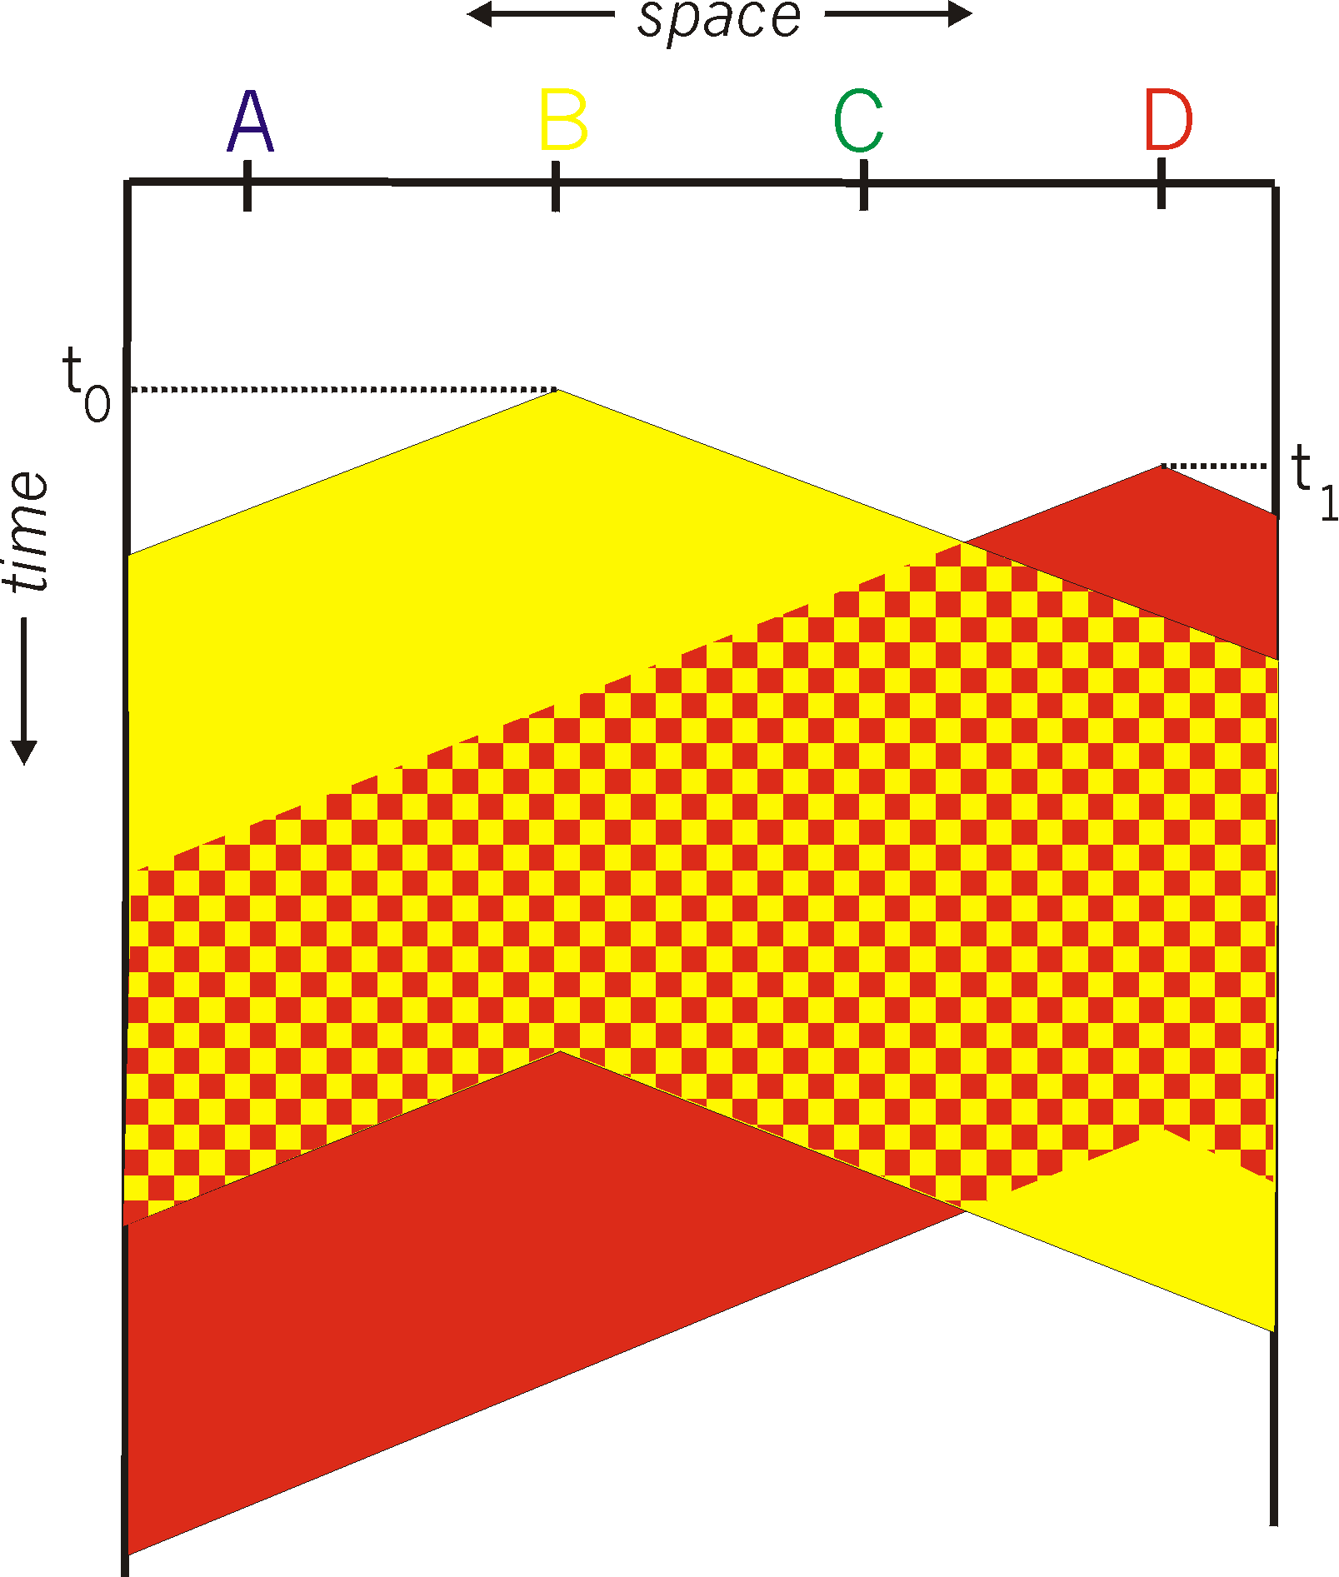
CSMA: collisions
spatial layout of nodes
collisions can still occur with carrier sensing:
propagation delay means two nodes may not hear each other’s just-started transmission
collision: entire packet transmission time wasted
distance & propagation delay play role in in determining collision probability

Slide 31
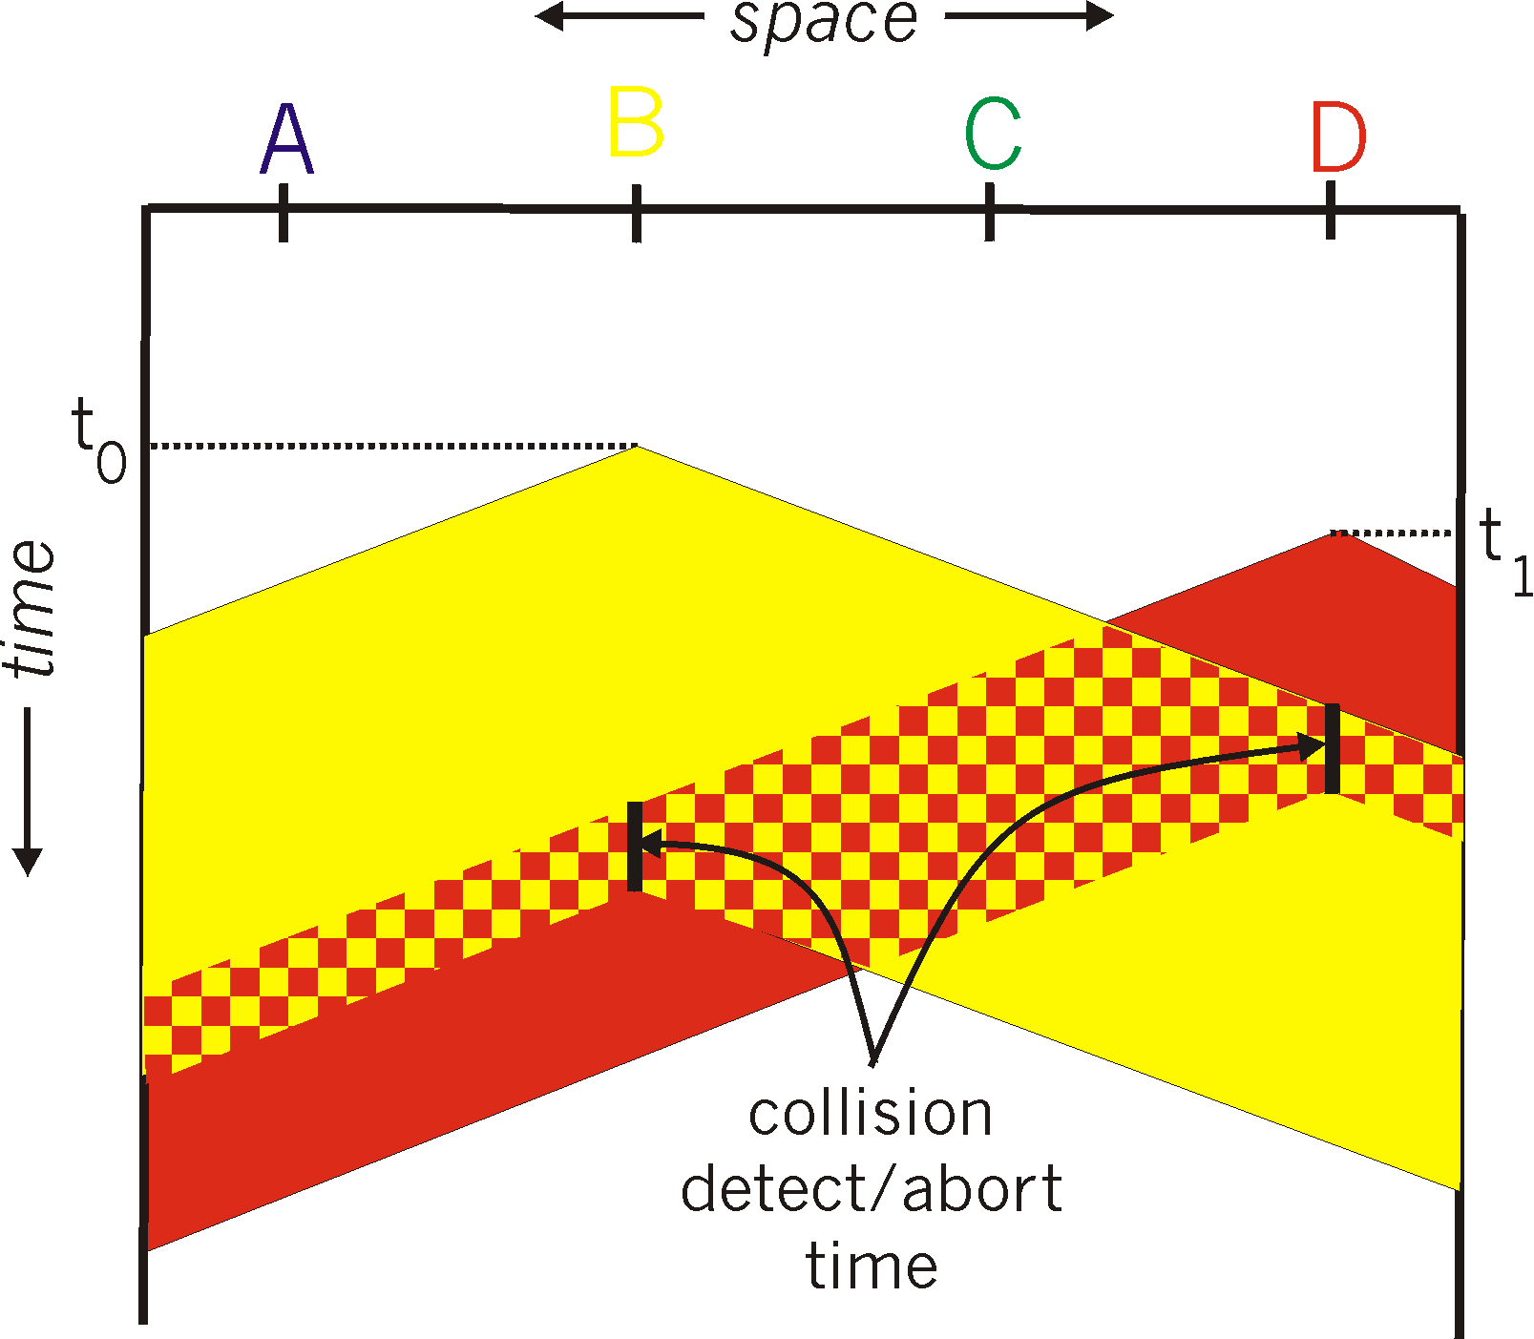
CSMA/CD:
spatial layout of nodes
CSMA/CD reduces the amount of time wasted in collisions
transmission aborted on collision detection

Slide 32
Ethernet CSMA/CD algorithm
Ethernet receives datagram from network layer, creates frame
If Ethernet senses channel:
if idle: start frame transmission.
if busy: wait until channel idle, then transmit
If entire frame transmitted without collision - done!
If another transmission detected while sending: abort, send jam signal
After aborting, enter binary (exponential) backoff:
after mth collision, chooses K at random from {0,1,2, …, 2^{m}-1}. Ethernet waits K·512 bit times, returns to Step 2
more collisions: longer backoff interval
Notes:
For Ethernet, the actual amount of time a node waits is K # 512 bit times (i.e., K times the amount of time needed to send 512 bits into the Ethernet) and the maxi- mum value that n can take is capped at 10.

Slide 33
CSMA/CD efficiency
T_{prop} = max prop delay between 2 nodes in LAN
t_{trans} = time to transmit max-size frame
efficiency goes to 1
as t_{prop} goes to 0
as t_{trans} goes to infinity
better performance than ALOHA: and simple, cheap, decentralized!
Notes:
let dprop denote the maximum time it takes signal energy to propagate between any two adapters. Let dtrans be the time to transmit a maximum-size frame (approximately 1.2 msecs for a 10 Mbps Ethernet).

Slide 34
“Taking turns” MAC protocols
channel partitioning MAC protocols:
share channel efficiently and fairly at high load
inefficient at low load: delay in channel access, 1/N bandwidth allocated even if only 1 active node!
random access MAC protocols
efficient at low load: single node can fully utilize channel
high load: collision overhead
“taking turns” protocols
look for best of both worlds!

Slide 35
“Taking turns” MAC protocols
polling:
centralized controller “invites” other nodes to transmit in turn
typically used with “dumb” devices
concerns:
polling overhead
latency
single point of failure (master)
Bluetooth uses polling
data
poll
centralized controller
data
client devices
Notes:
The first drawback is that the protocol introduces a polling delay—the amount of time required to notify a node that it can transmit. If, for example, only one node is active, then the node will transmit at a rate less than R bps, as the master node must poll each of the inactive nodes in turn each time the active node has sent its maximum number of frames. The second drawback, which is potentially more serious, is that if the master node fails, the entire channel becomes inoperative. The Bluetooth protocol, which we will study in Section 6.3, is an example of a polling protocol.

Slide 36
“Taking turns” MAC protocols
T
token passing:
control token message explicitly passed from one node to next, sequentially
transmit while holding token
concerns:
token overhead
latency
single point of failure (token)
(nothing
to send)
T
data
Notes:
no master node
But it has its problems as well. For example, the failure of one node can crash the entire channel. Or if a node accidentally neglects to release the token, then some recovery procedure must be invoked to get the token back in circulation.

Slide 37
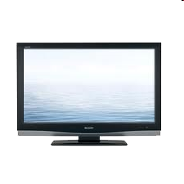
Cable access network: FDM, TDM and random access!
Internet frames, TV channels, control transmitted
downstream at different frequencies
cable headend
…
CMTS
…
splitter
cable
modem
ISP
cable modem
termination system
multiple downstream (broadcast) FDM channels: up to 1.6 Gbps/channel
single CMTS transmits into channels
multiple upstream channels (up to 1 Gbps/channel)
multiple access: all users contend (random access) for certain upstream channel time slots; others assigned TDM

Slide 38
Cable access network:
MAP frame for
Interval [t1, t2]
CMTS
Downstream channel i
Upstream channel j
cable headend
t₁
t₂
Residences with cable modems
Minislots containing
minislots request frames
Assigned minislots containing cable modem
upstream data frames
DOCSIS: data over cable service interface specification
FDM over upstream, downstream frequency channels
TDM upstream: some slots assigned, some have contention
downstream MAP frame: assigns upstream slots
request for upstream slots (and data) transmitted random access (binary backoff) in selected slots

Slide 39
Summary of MAC protocols
channel partitioning, by time, frequency or code
Time Division, Frequency Division
random access (dynamic),
ALOHA, S-ALOHA, CSMA, CSMA/CD
carrier sensing: easy in some technologies (wire), hard in others (wireless)
CSMA/CD used in Ethernet
CSMA/CA used in 802.11
taking turns
polling from central site, token passing
Bluetooth, FDDI, token ring

Slide 40
Link layer, LANs: roadmap
introduction
error detection, correction
multiple access protocols
LANs
addressing, ARP
Ethernet
switches
VLANs
link virtualization: MPLS
data center networking
a day in the life of a web request

Slide 41
MAC addresses
32-bit IP address:
network-layer address for interface
used for layer 3 (network layer) forwarding
e.g.: 128.119.40.136
MAC (or LAN or physical or Ethernet) address:
function: used “locally” to get frame from one interface to another physically-connected interface (same subnet, in IP-addressing sense)
48-bit MAC address (for most LANs) burned in NIC ROM, also sometimes software settable
e.g.: 1A-2F-BB-76-09-AD
hexadecimal (base 16) notation
(each “numeral” represents 4 bits)

Slide 42
MAC addresses
each interface on LAN
has unique 48-bit MAC address
has a locally unique 32-bit IP address (as we’ve seen)
137.196.7.78
1A-2F-BB-76-09-AD
LAN
(wired or wireless)
137.196.7/24
71-65-F7-2B-08-53
58-23-D7-FA-20-B0
137.196.7.23
137.196.7.14
0C-C4-11-6F-E3-98
137.196.7.88

Slide 43
MAC addresses
MAC address allocation administered by IEEE
manufacturer buys portion of MAC address space (to assure uniqueness)
analogy:
MAC address: like Social Security Number
IP address: like postal address
MAC flat address: portability
can move interface from one LAN to another
recall IP address not portable: depends on IP subnet to which node is attached

Slide 44
ARP: address resolution protocol
Question: how to determine interface’s MAC address, knowing its IP address?
ARP table: each IP node (host, router) on LAN has table
ARP
137.196.7.78
IP/MAC address mappings for some LAN nodes:
< IP address; MAC address; TTL>
TTL (Time To Live): time after which address mapping will be forgotten (typically 20 min)
1A-2F-BB-76-09-AD
ARP
ARP
LAN
71-65-F7-2B-08-53
58-23-D7-FA-20-B0
137.196.7.23
137.196.7.14
ARP
0C-C4-11-6F-E3-98
137.196.7.88

Slide 45
ARP protocol in action
example: A wants to send datagram to B
B’s MAC address not in A’s ARP table, so A uses ARP to find B’s MAC address
A broadcasts ARP query, containing B's IP addr
destination MAC address = FF-FF-FF-FF-FF-FF
all nodes on LAN receive ARP query
1
Ethernet frame (sent to FF-FF-FF-FF-FF-FF)
C
Source MAC: 71-65-F7-2B-08-53
Source IP: 137.196.7.23
Target IP address: 137.196.7.14
…
ARP table in A
IP addr
MAC addr
TTL
TTL
A
B
1
71-65-F7-2B-08-53
58-23-D7-FA-20-B0
137.196.7.23
137.196.7.14
D

Slide 46
ARP protocol in action
example: A wants to send datagram to B
B’s MAC address not in A’s ARP table, so A uses ARP to find B’s MAC address
ARP message into Ethernet frame (sent to 71-65-F7-2B-08-53)
C
Target IP address: 137.196.7.14
Target MAC address:
58-23-D7-FA-20-B0
…
ARP table in A
IP addr
MAC addr
TTL
TTL
A
B
2
71-65-F7-2B-08-53
58-23-D7-FA-20-B0
137.196.7.23
137.196.7.14
2
B replies to A with ARP response, giving its MAC address
D

Slide 47
ARP protocol in action
example: A wants to send datagram to B
B’s MAC address not in A’s ARP table, so A uses ARP to find B’s MAC address
C
ARP table in A
IP addr
MAC addr
TTL
TTL
A
B
137.196.
7.14
58-23-D7-FA-20-B0
500
71-65-F7-2B-08-53
58-23-D7-FA-20-B0
137.196.7.23
137.196.7.14
3
A receives B’s reply, adds B entry into its local ARP table
D

Slide 48

Routing to another subnet: addressing
walkthrough: sending a datagram from A to B via R
focus on addressing – at IP (datagram) and MAC layer (frame) levels
assume that:
A knows B’s IP address
A knows IP address of first hop router, R (how?)
A knows R’s MAC address (how?)
A
R
B
111.111.111.111
74-29-9C-E8-FF-55
222.222.222.222
49-BD-D2-C7-56-2A
222.222.222.220
1A-23-F9-CD-06-9B
111.111.111.112
111.111.111.110
CC-49-DE-D0-AB-7D
E6-E9-00-17-BB-4B
222.222.222.221
88-B2-2F-54-1A-0F

Slide 49
Routing to another subnet: addressing
A creates IP datagram with IP source A, destination B
A creates link-layer frame containing A-to-B IP datagram
R's MAC address is frame’s destination
MAC src: 74-29-9C-E8-FF-55
MAC dest: E6-E9-00-17-BB-4B
IP
Eth
Phy
IP src: 111.111.111.111
IP dest: 222.222.222.222
A
R
B
111.111.111.111
74-29-9C-E8-FF-55
222.222.222.222
49-BD-D2-C7-56-2A
222.222.222.220
1A-23-F9-CD-06-9B
111.111.111.112
111.111.111.110
CC-49-DE-D0-AB-7D
E6-E9-00-17-BB-4B
222.222.222.221
88-B2-2F-54-1A-0F

Slide 50
Routing to another subnet: addressing
frame sent from A to R
frame received at R, datagram removed, passed up to IP
MAC src: 74-29-9C-E8-FF-55
MAC dest: E6-E9-00-17-BB-4B
IP src: 111.111.111.111
IP dest: 222.222.222.222
IP
Eth
Phy
IP src: 111.111.111.111
IP dest: 222.222.222.222
IP
Eth
Phy
A
R
B
111.111.111.111
74-29-9C-E8-FF-55
222.222.222.222
49-BD-D2-C7-56-2A
222.222.222.220
1A-23-F9-CD-06-9B
111.111.111.112
111.111.111.110
CC-49-DE-D0-AB-7D
E6-E9-00-17-BB-4B
222.222.222.221
88-B2-2F-54-1A-0F

Slide 51
Routing to another subnet: addressing
R determines outgoing interface, passes datagram with IP source A, destination B to link layer
R creates link-layer frame containing A-to-B IP datagram. Frame destination address: B's MAC address
MAC src: 1A-23-F9-CD-06-9B
MAC dest: 49-BD-D2-C7-56-2A
IP
Eth
Phy
IP src: 111.111.111.111
IP dest: 222.222.222.222
A
R
B
111.111.111.111
74-29-9C-E8-FF-55
222.222.222.222
49-BD-D2-C7-56-2A
222.222.222.220
1A-23-F9-CD-06-9B
111.111.111.112
111.111.111.110
CC-49-DE-D0-AB-7D
E6-E9-00-17-BB-4B
222.222.222.221
88-B2-2F-54-1A-0F

Slide 52
Routing to another subnet: addressing
R determines outgoing interface, passes datagram with IP source A, destination B to link layer
R creates link-layer frame containing A-to-B IP datagram. Frame destination address: B's MAC address
MAC src: 1A-23-F9-CD-06-9B
MAC dest: 49-BD-D2-C7-56-2A
transmits link-layer frame
IP
Eth
Phy
IP
Eth
Phy
IP src: 111.111.111.111
IP dest: 222.222.222.222
A
R
B
111.111.111.111
74-29-9C-E8-FF-55
222.222.222.222
49-BD-D2-C7-56-2A
222.222.222.220
1A-23-F9-CD-06-9B
111.111.111.112
111.111.111.110
CC-49-DE-D0-AB-7D
E6-E9-00-17-BB-4B
222.222.222.221
88-B2-2F-54-1A-0F

Slide 53
Routing to another subnet: addressing
B receives frame, extracts IP datagram destination B
B passes datagram up protocol stack to IP
IP src: 111.111.111.111
IP dest: 222.222.222.222
IP
Eth
Phy
IP
Eth
Phy
A
R
B
111.111.111.111
74-29-9C-E8-FF-55
222.222.222.222
49-BD-D2-C7-56-2A
222.222.222.220
1A-23-F9-CD-06-9B
111.111.111.112
111.111.111.110
CC-49-DE-D0-AB-7D
E6-E9-00-17-BB-4B
222.222.222.221
88-B2-2F-54-1A-0F

Slide 54
Link layer, LANs: roadmap
introduction
error detection, correction
multiple access protocols
LANs
addressing, ARP
Ethernet
switches
VLANs
link virtualization: MPLS
data center networking
a day in the life of a web request

Slide 55
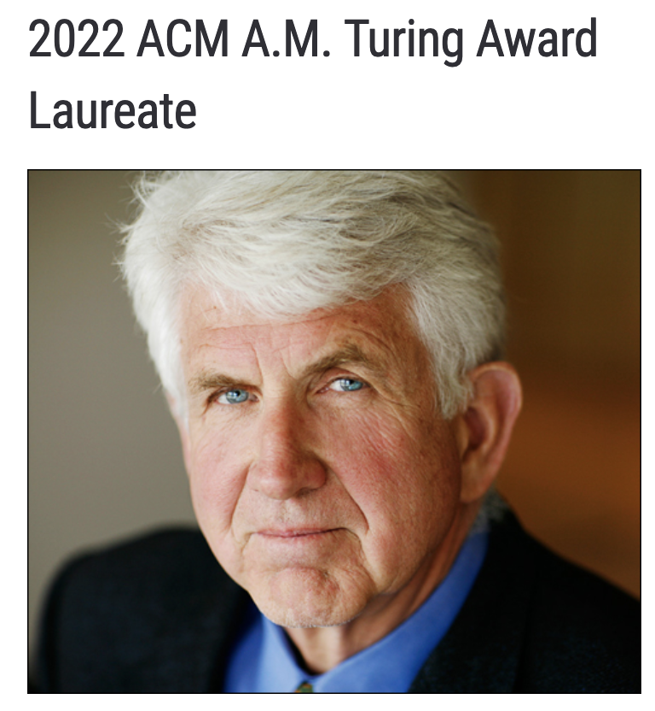
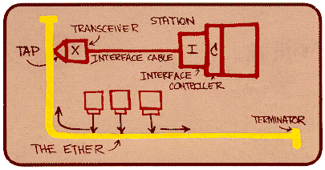
Ethernet
“dominant” wired LAN technology:
first widely used LAN technology
simpler, cheap
kept up with speed race: 10 Mbps – 400 Gbps
single chip, multiple speeds (e.g., Broadcom BCM5761)
Bob Metcalfe: Ethernet co-inventor,
2022 ACM Turing Award recipient
Metcalfe’s Ethernet sketch
https://www.uspto.gov/learning-and-resources/journeys-innovation/audio-stories/defying-doubters

Slide 56
Ethernet: physical topology
bus: popular through mid 90s
all nodes in same collision domain (can collide with each other)
switched: prevails today
active link-layer 2 switch in center
each “spoke” runs a (separate) Ethernet protocol (nodes do not collide with each other)
bus: coaxial cable
switched

Slide 57
Ethernet frame structure
sending interface encapsulates IP datagram (or other network layer protocol packet) in Ethernet frame
type
preamble
dest.
address
source
address
data (payload)
CRC
preamble:
used to synchronize receiver, sender clock rates
7 bytes of 10101010 followed by one byte of 10101011

Slide 58
Ethernet frame structure (more)
type
preamble
dest.
address
source
address
data (payload)
CRC
addresses: 6 byte source, destination MAC addresses
if adapter receives frame with matching destination address, or with broadcast address (e.g., ARP packet), it passes data in frame to network layer protocol
otherwise, adapter discards frame
type: indicates higher layer protocol
mostly IP but others possible, e.g., Novell IPX, AppleTalk
used to demultiplex up at receiver
CRC: cyclic redundancy check at receiver
error detected: frame is dropped

Slide 59
Ethernet: unreliable, connectionless
connectionless: no handshaking between sending and receiving NICs
unreliable: receiving NIC doesn’t send ACKs or NAKs to sending NIC
data in dropped frames recovered only if initial sender uses higher layer rdt (e.g., TCP), otherwise dropped data lost
Ethernet’s MAC protocol: unslotted CSMA/CD with binary backoff

Slide 60
Link layer, LANs: roadmap
introduction
error detection, correction
multiple access protocols
LANs
addressing, ARP
Ethernet
switches
VLANs
link virtualization: MPLS
data center networking
a day in the life of a web request

Slide 61
Ethernet switch
Switch is a link-layer device: takes an active role
store, forward Ethernet (or other type of) frames
examine incoming frame’s MAC address, selectively forward frame to one-or-more outgoing links when frame is to be forwarded on segment, uses CSMA/CD to access segment
transparent: hosts unaware of presence of switches
plug-and-play, self-learning
switches do not need to be configured

Slide 62
Switch: multiple simultaneous transmissions
hosts have dedicated, direct connection to switch
switches buffer packets
Ethernet protocol used on each incoming link, so:
no collisions; full duplex
each link is its own collision domain
A
C’
B
1
2
6
3
5
4
B’
C
A’
switching: A-to-A’ and B-to-B’ can transmit simultaneously, without collisions
switch with six interfaces (1,2,3,4,5,6)

Slide 63

Switch: multiple simultaneous transmissions
hosts have dedicated, direct connection to switch
switches buffer packets
Ethernet protocol used on each incoming link, so:
no collisions; full duplex
each link is its own collision domain
A
C’
B
1
2
6
3
5
4
B’
C
A’
switching: A-to-A’ and B-to-B’ can transmit simultaneously, without collisions
but A-to-A’ and C to A’ can not happen simultaneously
switch with six interfaces (1,2,3,4,5,6)

Slide 64
Switch forwarding table
Q: how does switch know A’ reachable via interface 4, B’ reachable via interface 5?
A
C’
B
A: each switch has a switch table, each entry:
(MAC address of host, interface to reach host, time stamp)
looks like a routing table!
1
2
6
3
5
4
B’
C
A’
Q: how are entries created, maintained in switch table?
something like a routing protocol?

Slide 65
Switch: self-learning
Source: A
switch learns which hosts can be reached through which interfaces
Dest: A’
A A’
A
C’
B
when frame received, switch “learns” location of sender: incoming LAN segment
1
2
6
3
5
4
records sender/location pair in switch table
B’
C
A’
Switch table
(initially empty)
MAC addr interface TTL
A
1
60

Slide 66
Switch: frame filtering/forwarding
when frame received at switch:
1. record incoming link, MAC address of sending host
2. index switch table using MAC destination address
3. if entry found for destination then {
if destination on segment from which frame arrived then drop frame
else forward frame on interface indicated by entry
}
else flood /* forward on all interfaces except arriving interface */

Slide 67
Self-learning, forwarding: example
Source: A
Dest: A’
frame destination, A’, location unknown:
A A’
flood
A
C’
B
destination A location known:
selectively send
on just one link
1
2
6
A A’
A A’
A A’
A A’
A A’
3
5
4
B’
C
A’ A
A’
MAC addr interface TTL
A
1
60
switch table
(initially empty)
A’
4
60

Slide 68


Interconnecting switches
self-learning switches can be connected together:
S₄
S₁
S₃
A
S₂
F
I
B
C
D
E
G
H
Q: sending from A to G - how does S₁ know to forward frame destined to G via S₄ and S₃?
A: self learning! (works exactly the same as in single-switch case!)

Slide 69
Self-learning multi-switch example
Suppose C sends frame to I, I responds to C
S₄
S₁
S₃
A
S₂
F
I
B
C
D
E
G
H
Q: show switch tables and packet forwarding in S₁, S₂, S₃, S₄

Slide 70
Switches vs. routers
application
transport
network
link
physical
both are store-and-forward:
routers: network-layer devices (examine network-layer headers)
switches: link-layer devices (examine link-layer headers)
datagram
frame
link
physical
frame
switch
network
link
physical
datagram
both have forwarding tables:
routers: compute tables using routing algorithms, IP addresses
switches: learn forwarding table using flooding, learning, MAC addresses
frame
application
transport
network
link
physical
6-70

